Slide 1

Skincare product analysis
Christopher Lee
5/7/2025

Slide 2
Agenda
Introduction
Data Sources
Specifications
Data Structure
Data Loading and Storage
Creating Tables
Data Cleaning / Transformation
Data Analysis
Visualizations

Slide 3
Introduction
The beauty and skincare industry is rapidly changing, driven by new consumer demands, digital influence, and the desire for ethical, personalized products. This study uses two Kaggle datasets—Most Used Beauty & Cosmetics Products in the World and Sephora Products and Skincare Reviews—to analyze these trends. The datasets provide product details, brand attributes, user ratings, ingredients, pricing, and demographics. Hive QL was used to clean, merge, and analyze data, addressing product popularity, ingredient satisfaction correlation, and the impact of brand and price on purchases.

Slide 4
Links to public dataset
Sephora Products and Skincare Reviews: https://www.kaggle.com/datasets/nadyinky/sephora-products-and-skincare-reviews
Top Beauty & Cosmetics Products Worldwide 2024: https://www.kaggle.com/datasets/waqi786/most-used-beauty-cosmetics-products-in-the-world

Slide 5

Assembled Data sources uploaded in hdfs
sephora_reviews.csv
Information bout all beauty products from the Sephora online store and user reviews.
top_world_products.csv:
Dataset which is an overview of the most used beauty and cosmetics products across the world.

Slide 6
Specifications
Data:
4.27 GB
Sephora Products: https://www.kaggle.com/datasets/nadyinky/sephora-products-and-skincare-reviews
Global Cosmetic Products: https://www.kaggle.com/datasets/waqi786/most-used-beauty-cosmetics-products-in-the-world
Hardware
Nodes: 5
3 Worker Nodes
2 Master Nodes
CPU Speed: 2.45 GhZ
Disk Space: 31 GB
31 GB x 5 = 155 GB

Slide 7
Originality
This project is unique in its integration of large-scale consumer review data with product metadata to analyze beauty trends. Unlike typical industry reports, it uses two Kaggle datasets to link user sentiment, product ingredients, and pricing in a structured, data-driven way.
Its originality lies in the use of Hive QL to clean and analyze the data at scale—an uncommon approach in beauty market studies. By connecting product features with consumer behavior, the project offers a practical, scalable method for understanding what drives product success.

Slide 8
Process
Download Data
Append files (Python)
Upload files into HDFS
Wrangle data
Drop Columns
Rename Columns
Normalize Values
Export Data
Create Visualizations

Slide 9
Schema example
Sephora Reviews Table
Product_ID
Product_Name
Brand_ID
Brand_Name
Loves
Rating
Ingredients
Price_USD
Top World Products Table
Product_Name
Brand_Name
Category
Price_USD
Rating
Reviews
Skin_Type
Ingredients

Slide 10
Data load process
Secure Copy into Linux file system
Example: scp sephora_reviews.csv clee219@144.24.13.0:~
Load the file from Linux file system into HDFS
hdfs dfs -put sephora_reviews.csv project/reviews

Slide 11
Creating tables
Tables need to be created to be able to analyze data in Hive.
Example:
CREATE EXTERNAL TABLE IF NOT EXISTS sephora_reviews_source (
...column definitions...
)
ROW FORMAT DELIMITED
FIELDS TERMINATED BY ','
LOCATION "/user/clee219/project/reviews"
TBLPROPERTIES ('skip.header.line.count' = '1');

Slide 12
Data cleansing
Set all string values to lowercase values
Trimmed all string values of additional blank spaces
Coalesce all null values to a usable value

Slide 13
Data Transformation making sense of headers
sephora_reviews table example
Product_id -> Product_ID
Loves_count -> Loves
top_world_products table example
Brand -> Brand_Name
Main_Ingredients -> Ingredients

Slide 14
Hive data analysis summary statistics
This analysis provides a clean, readable summary of key numerical insights about product price, rating, and number of reviews from the datasets, which can help you understand central tendencies, variation, and outliers.
Measures | Minimum | Maximum | Average
Values | Price | Ratings | Reviews​

Slide 15
Hive data analysis Individual statistics
This SQL query is performing descriptive statistical analysis on the data tables to extract insights about product price, rating, and review counts.
Measures | Mean | Median | Standard Deviation
Values | Price | Ratings | Reviews​

Slide 16
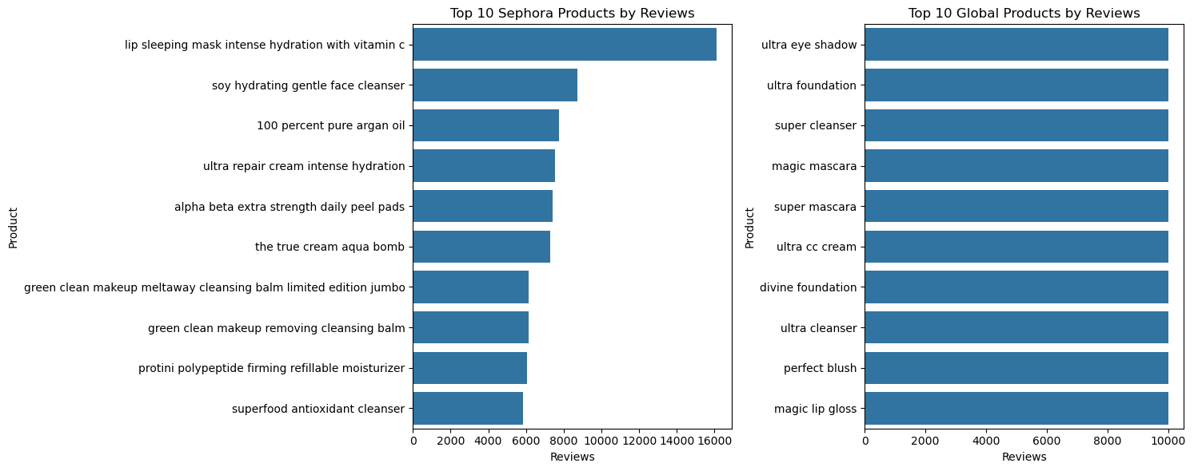
Bar chart – Sorted by review

Slide 17
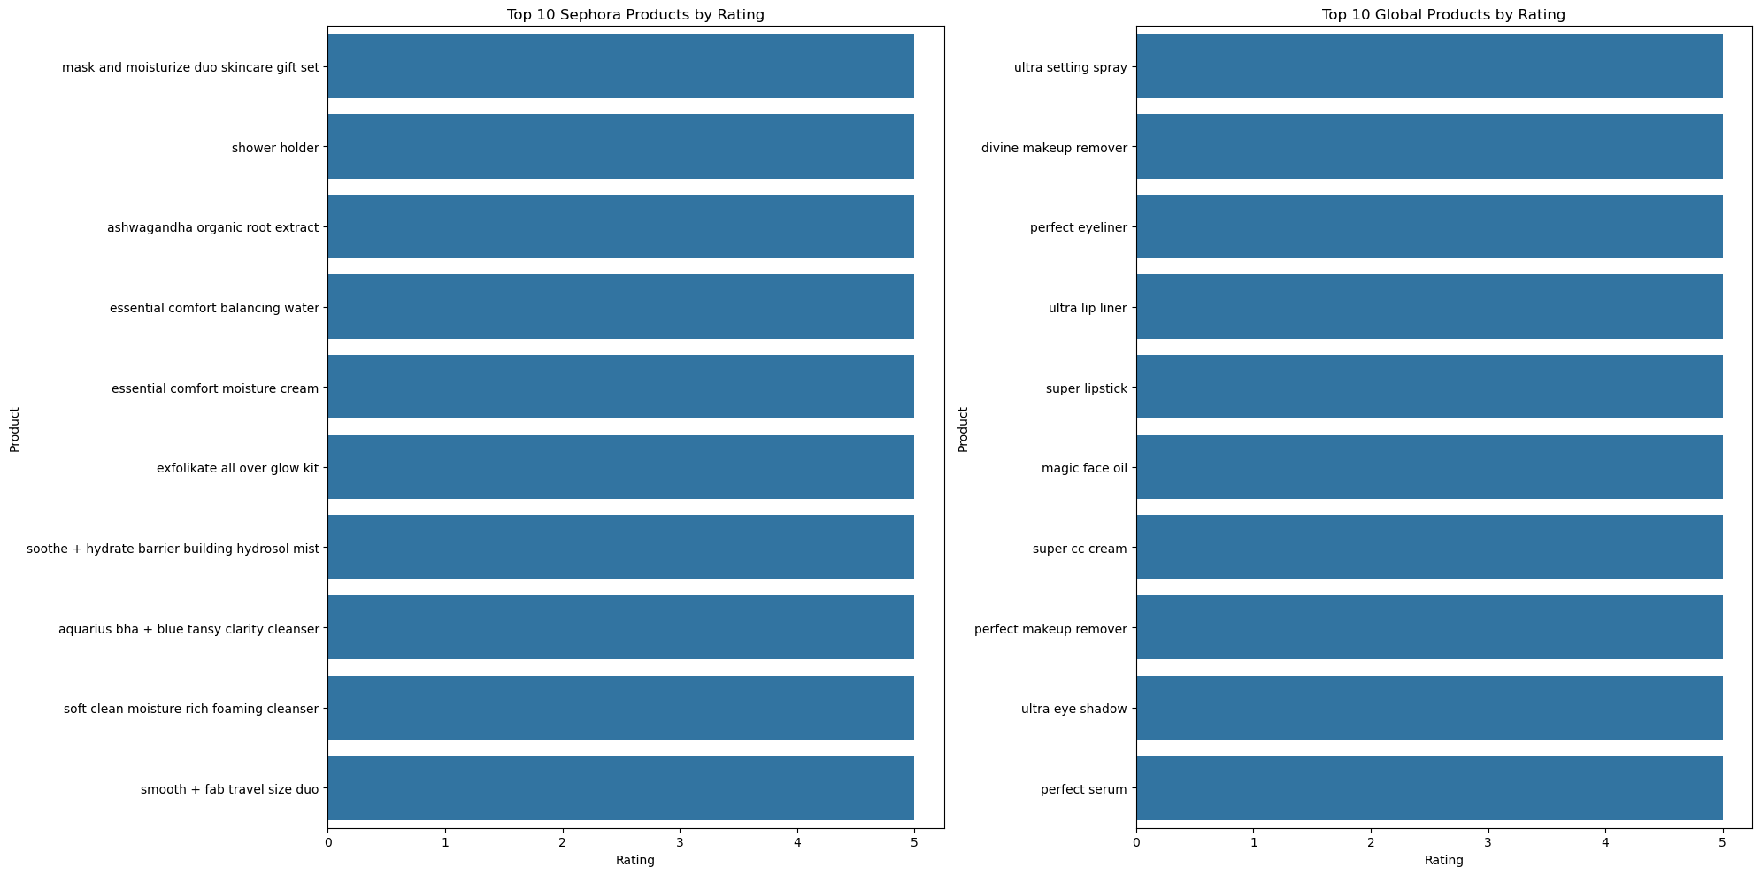
Bar chart – sorted by rating

Slide 18
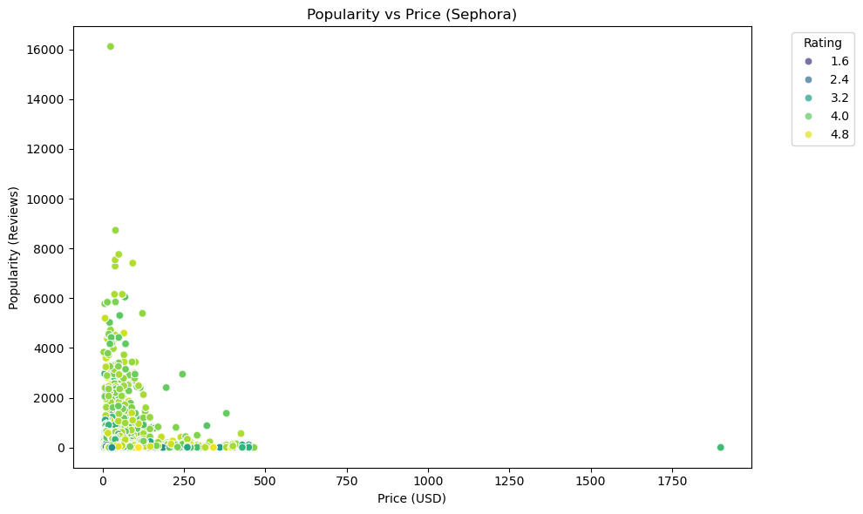
Scatterplot

Slide 19
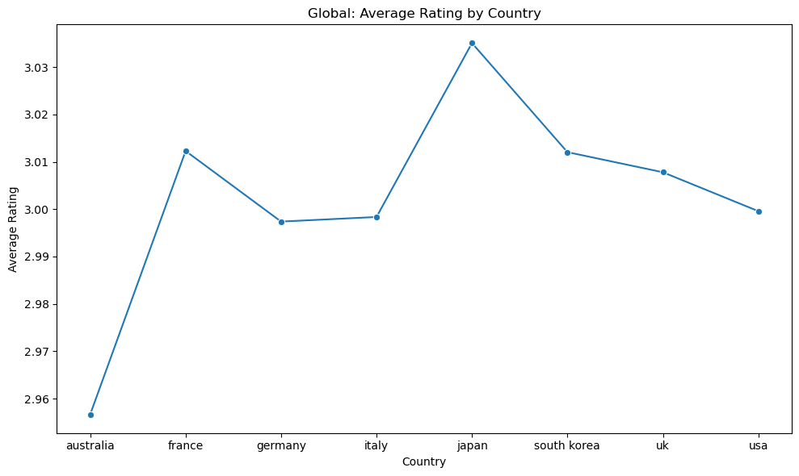
Line graph

Slide 20
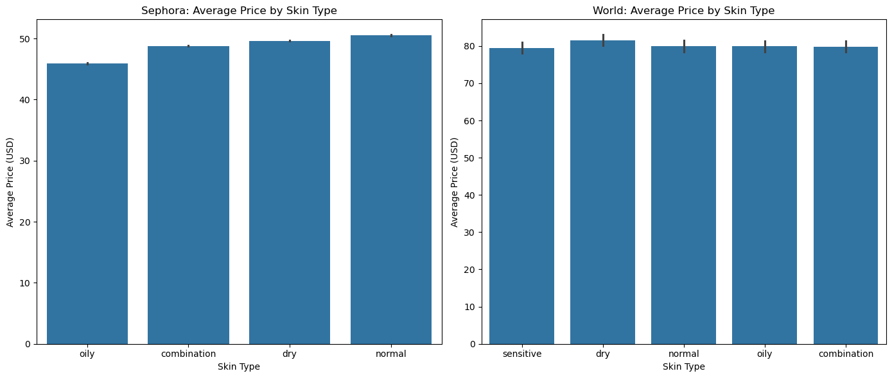
Bar chart – skin type / Price

Slide 21
THANK YOU
GitHub Repository

